Slide 1

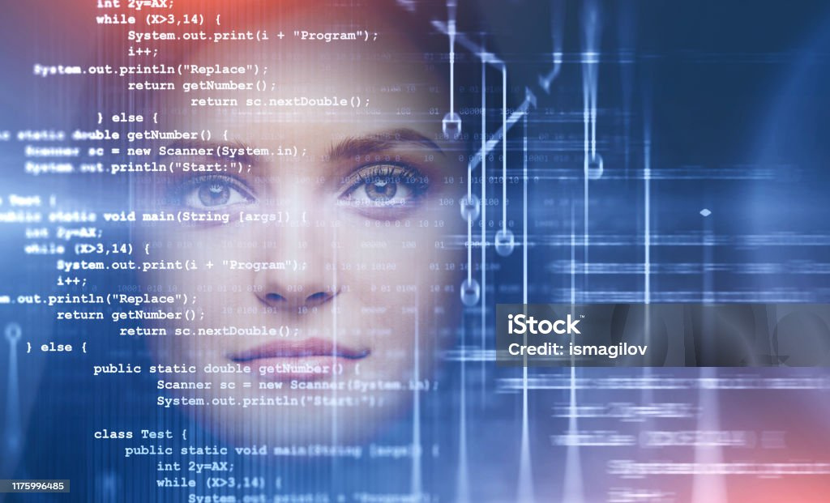
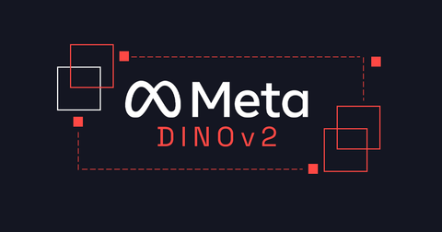



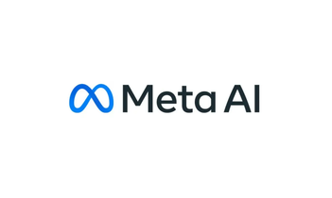
Lokahi Innovation In Healthcare Hackathon
MALAMA AI

Slide 2
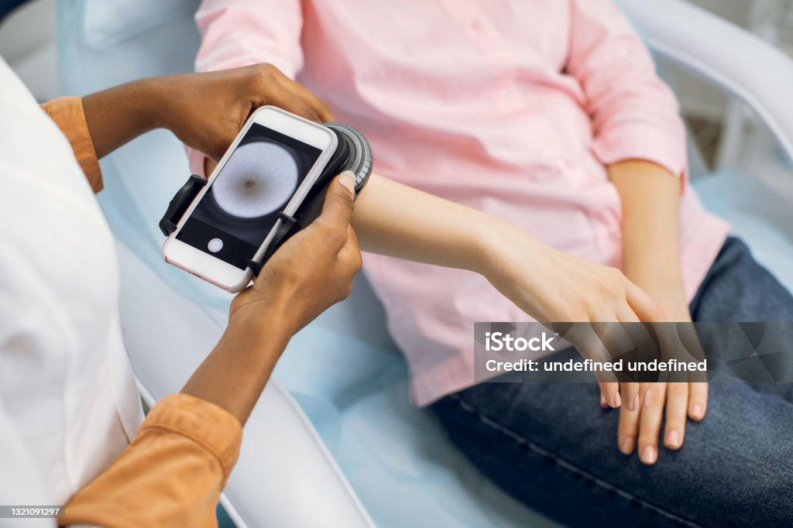
Project Overview
Skin diseases affect millions of people worldwide, with many conditions requiring early detection for effective treatment.
Malama is a Hawaiian word that means “to care”.
Malama Ai is an ai skin disease detection tool that accepts images of a skin patch and predicts the disease.

Slide 3
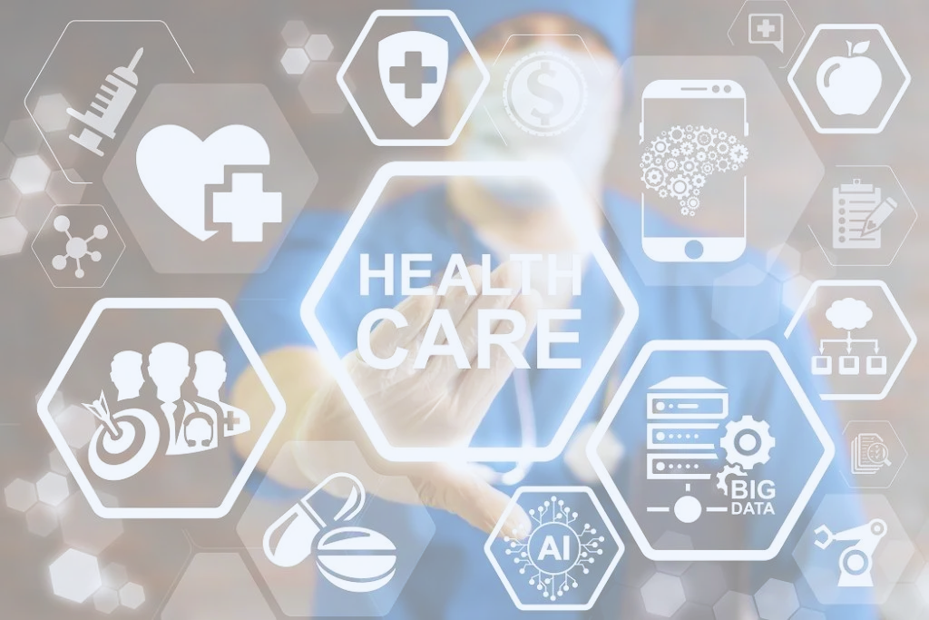
Problem Statement
Limited Access to Specialized Healthcare
Rural and remote communities often lack dermatology specialists
High cost of specialized medical consultations
Delayed Disease Detection
Many individuals ignore early skin condition symptoms
Limited health awareness and self-monitoring capabilities
Diagnostic Barriers
Professional skin disease diagnosis requires specialized expertise
Significant costs associated with in-person dermatological examinations

Slide 4
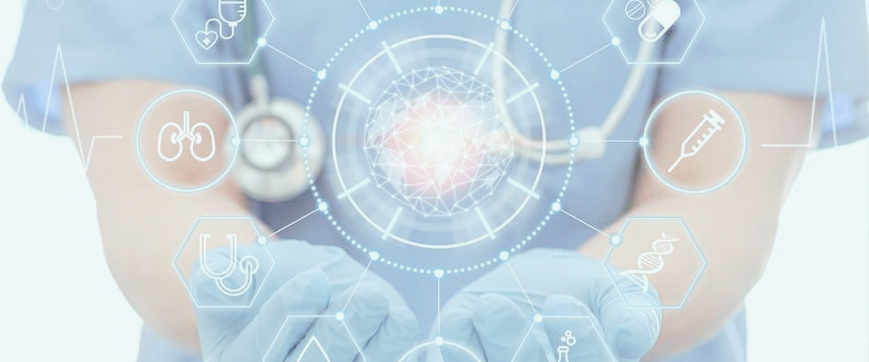
Core Solution
Malama is an AI-driven web application that enables users to:
Upload images of their skin conditions
Receive instant, preliminary disease classification
Get actionable recommendations for next steps

Slide 5

Core Solution
How it will provide Value
Affordable AI-Powered Diagnosis: A tool that provides instant feedback on skin issues.
Actionable Insights: Remedies, explanations, and guidance on when to seek professional care.
Convenience: Accessible anytime, anywhere, with just a smartphone and an internet connection.

Slide 6
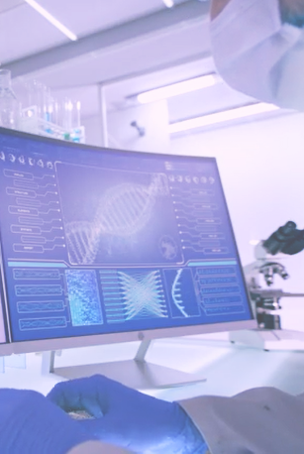
Impacts
Potential progression of treatable skin conditions.
Increased awareness and prevention of late diagnosis.
Improved diagnostic accuracy and enhanced patients outcomes.
Easy accessibility and efficiency and cost reduction.

Slide 7

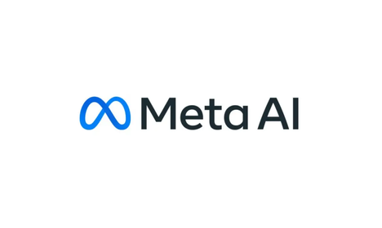
Technologies Deployed
User uploads an image
Web App (Next.js Frontend) sends image to Backend
Receives image from Web App
Passes image to Finetuned Model (built with Facebook's dinov2)
Finetuned Model classifies the image as a specific disease
Takes the disease classification from the Finetuned Model
Passes the classification to the Large Language Model (Llama 3.3, 70B)
Large Language Model processes the classification and generates a summary of the main points
Sends the summary back to the Web App (Next.js Frontend)
Receives the summary from the Backend
Displays the summary to the user
Allows the user to ask follow-up questions

Slide 8
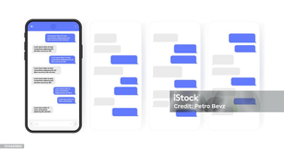
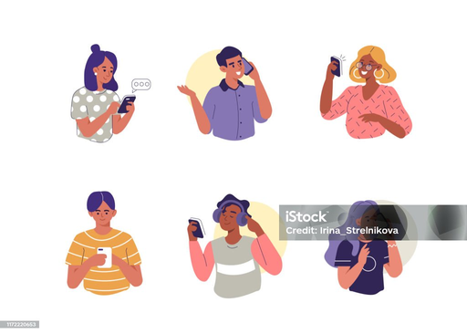
Technology Architecture
Dinov2 finetuned model
Upload picture of skin disease
dinov2 recieves image and makes a prediction
Takes classification from
finetuned model
and passes the
result to LLm
User
Show the summary and user can ask follow-up questions
Generates summary compared with the result from the model and send it back

Slide 9
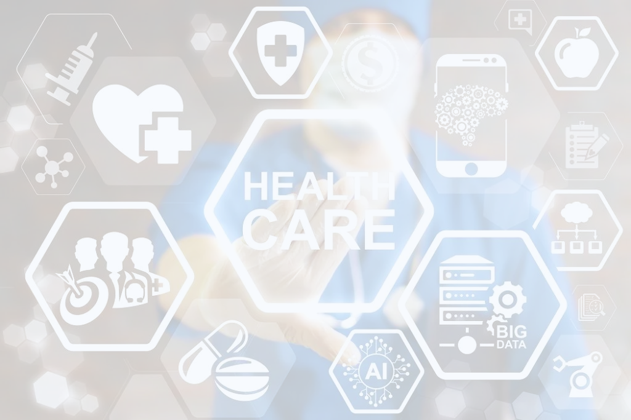
Demo

Slide 10
Target Audience
Primary Market:
Individuals aged 18-45 in urban and semi-urban areas with smartphone access.
Health-conscious users actively seeking skin care advice.
Secondary Market:
Clinics in rural areas to support practitioners without dermatology expertise.
Employers offering healthcare solutions for employees (B2B).

Slide 11
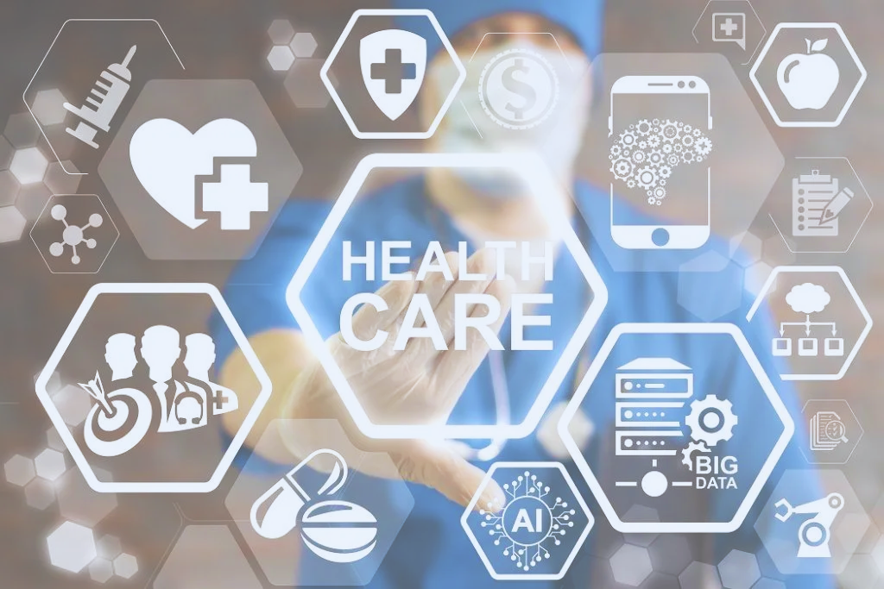
Business Model
Freemium Model:
Free Tier: Limited features like basic disease classification and general recommendations.
Paid Tier: Advanced features, including detailed condition analysis, personalized remedies, and dermatologist referrals.
Partnerships:
Dermatology clinics for referrals.
Skincare brands for treatment solutions and product recommendations.
Telemedicine platforms for integrating doctor consultations.
Enterprise Sales: Offer licensing to hospitals and clinics to integrate MalamaAI into their systems.

Slide 12
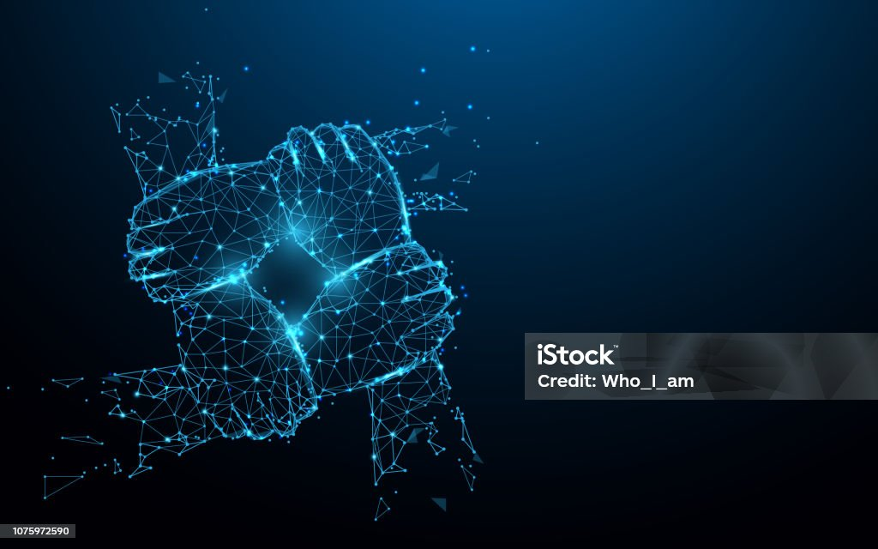
Team Members
L
Labiokor Chris-Odai
Roha Pathan
Hassan Mehmood
Okey Amy
LinkedIn
LinkedIn
LinkedIn
LinkedIn
GitHub
GitHub
GitHub
GitHub

Slide 13
